Slide 1
DevOPS for SCALA
Cloud Building
for Scala Enthusiasts
Michele Sciabarrà
michele@sciabarra.com

Slide 2

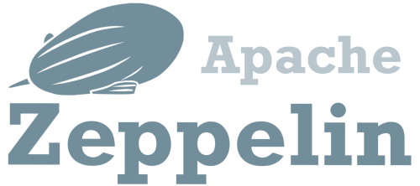



Let's do Big Data!

Slide 3
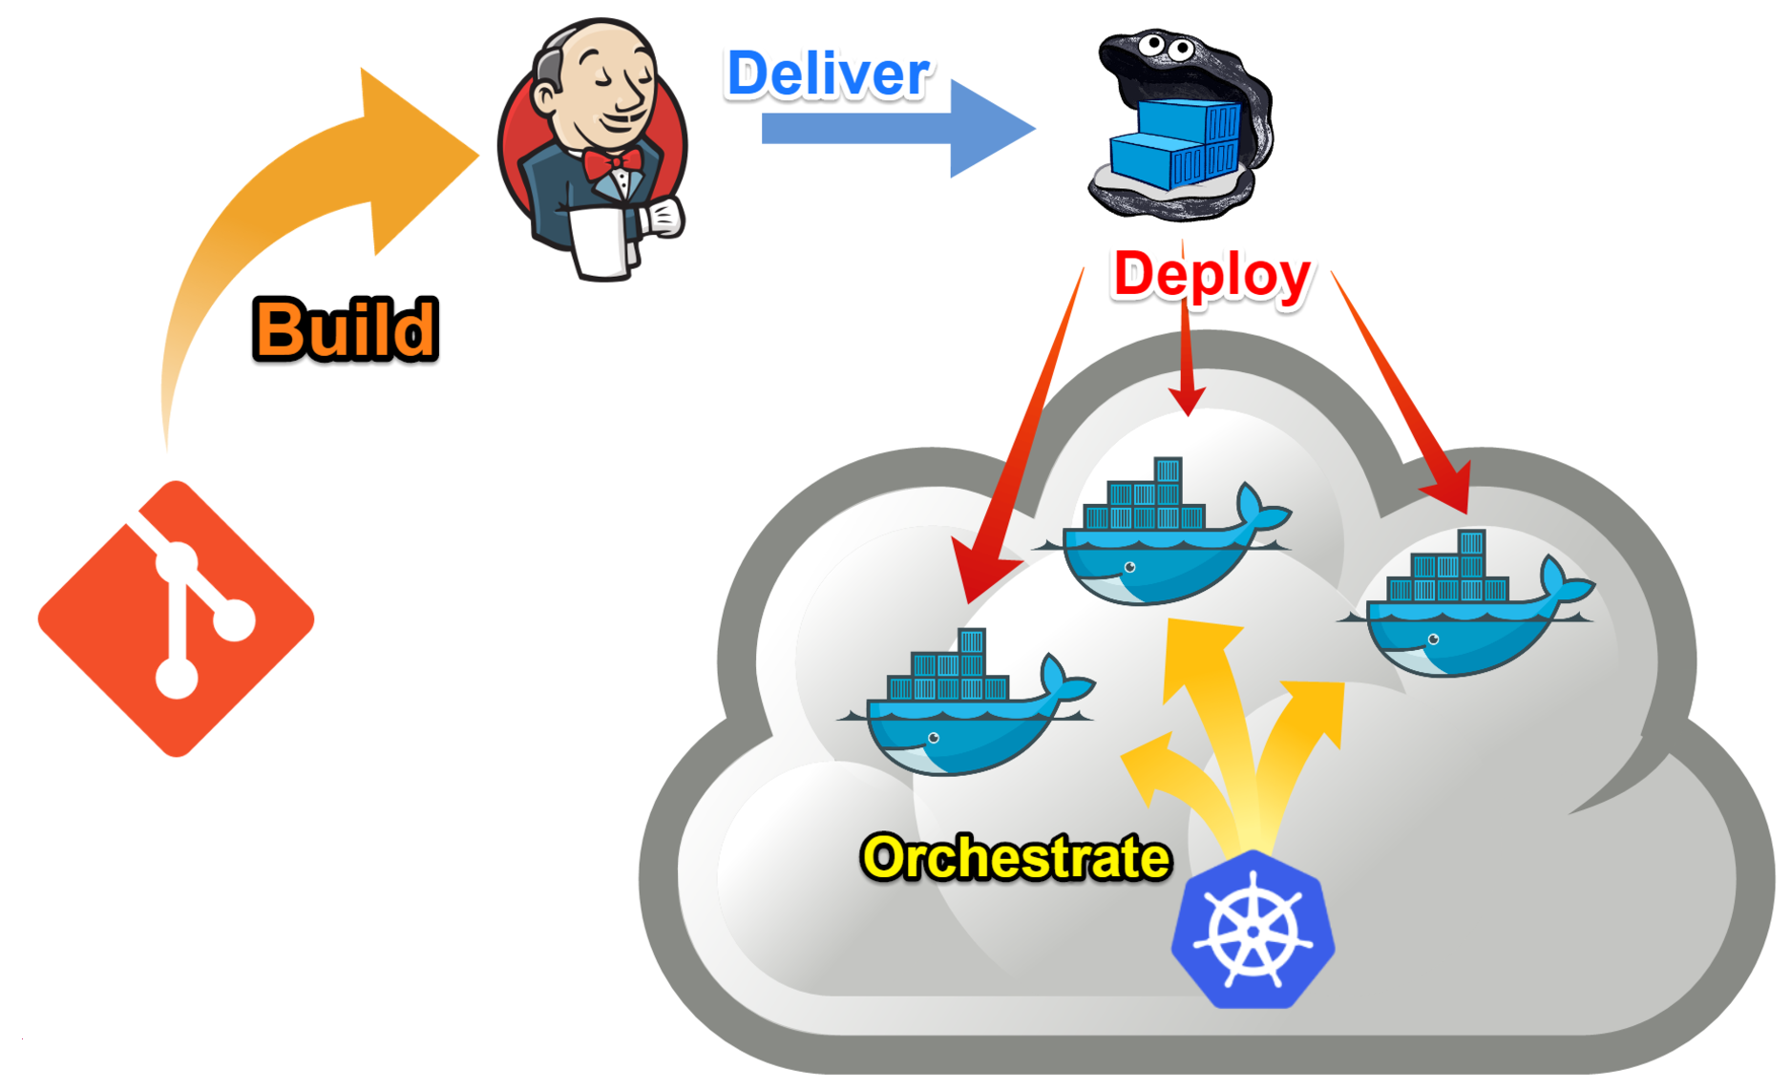

Mission Statement

Slide 4



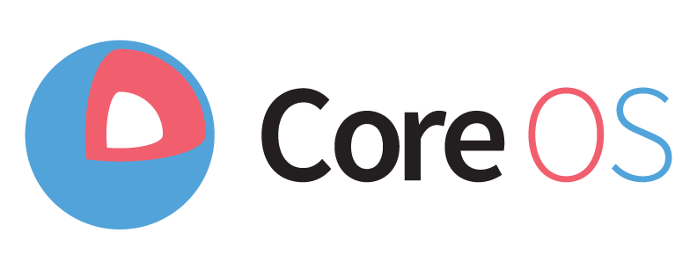
What I tried
Cloudera Distribution
DC/OS
Ambari
Tectonic

Slide 5

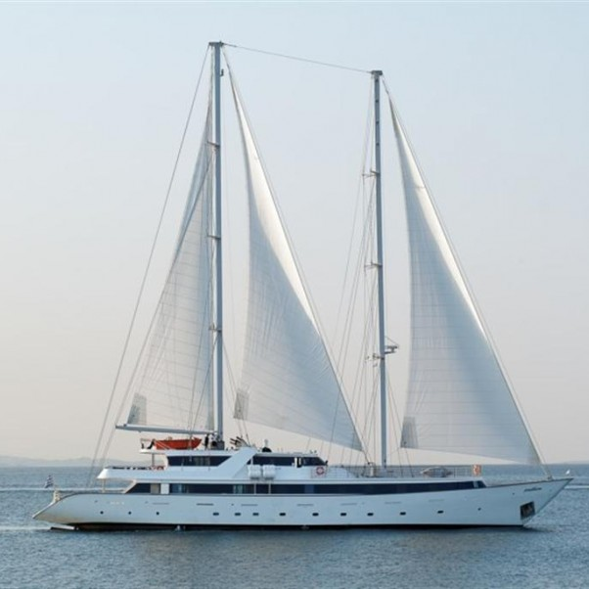
Tuning your requirements
What they sell
What you need

Slide 6
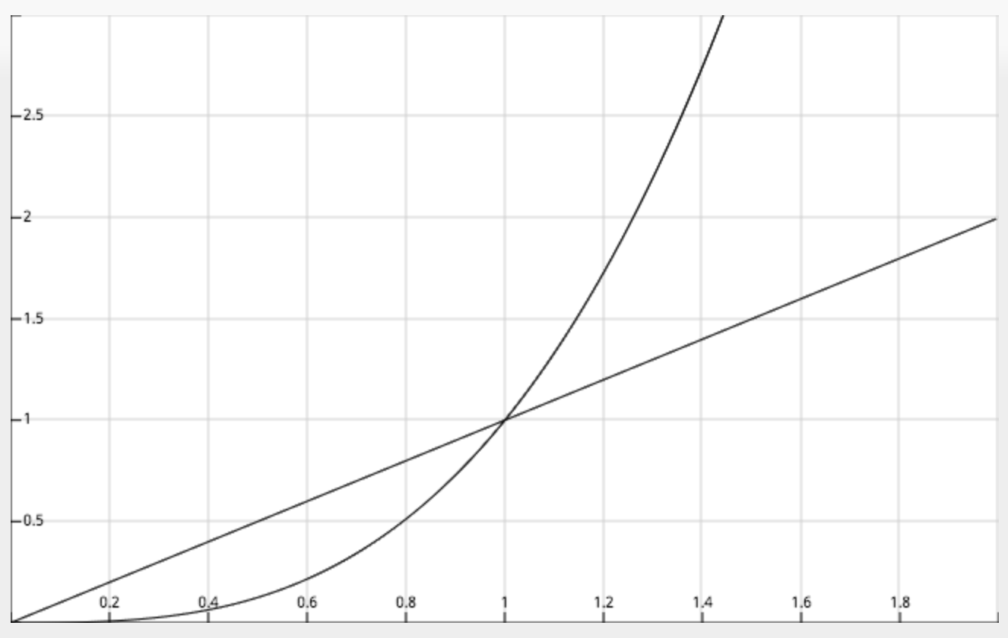
The problem with customisation
Effort
Third Part
Home Grown
Amount of Customisation

Slide 7
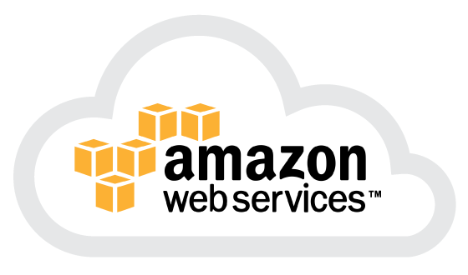
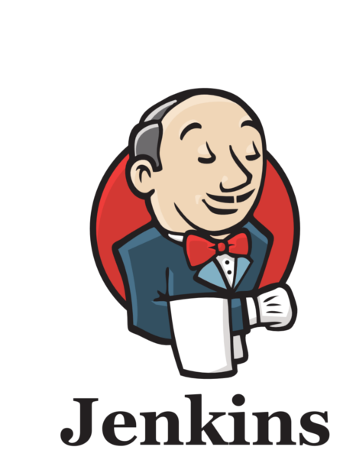
What I want
What I want:
Everything in AWS
Everything in Docker
Everything built with Jenkins
And, of course:
Easy customizability
Easy orchestration
Cheapest solution in the cloud

Slide 8


What I do NOT want
What I DO NOT want:
Hadoop
(even if I like it)
Unused components eating precious memory in the cloud
Be stuck to one version of a component

Slide 9
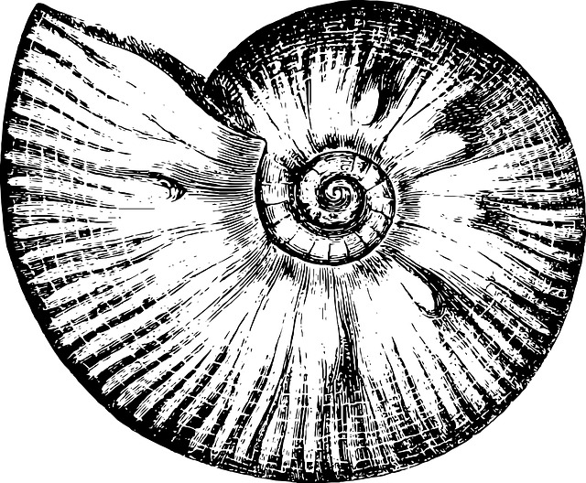

Introducing Mosaico
http://github.com
/sciabarra/Mosaico
It is not a distribution!
It is not a framework!
Open Source
It is a "starter kit" for
creating a cloud in AWS with CloudFormation
Installing Docker and Docker Swarm with Ansible
Building Images with Jenkins and SBT
Orchestrating services with Docker Compose
Ammonite
Warning: documentation not yet ready!

Slide 10
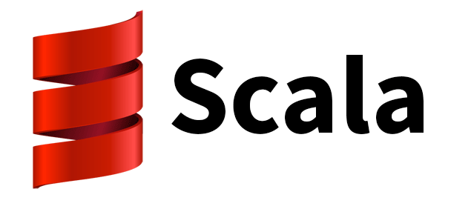
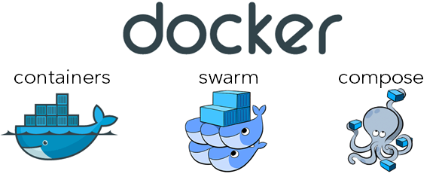
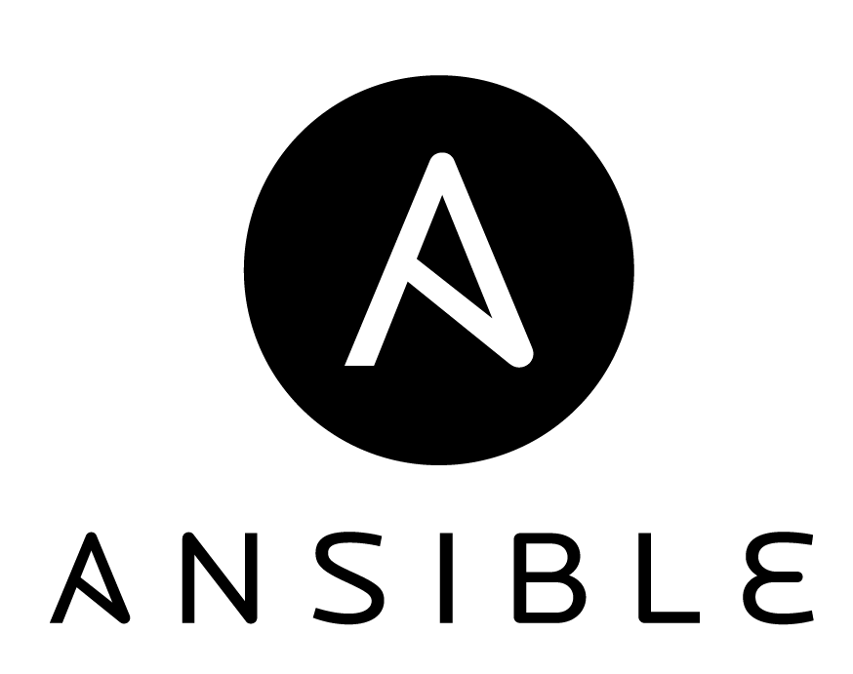
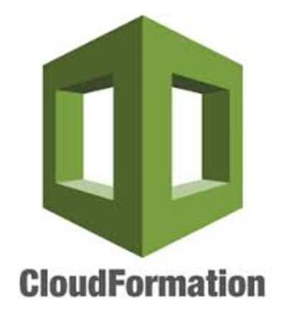
Building on the shoulders of giants
Ammonite

Slide 11

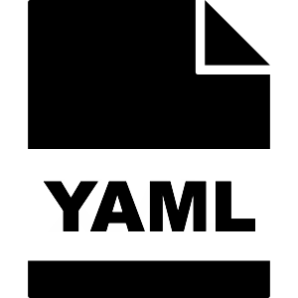
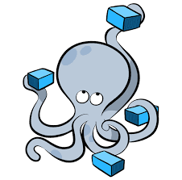
The real life of a DevOps

Slide 12


How I feel when I script with
BASH
SCALA

Slide 13



Bonus slide: Other feelings
PERL
PYTHON
RUBY

Slide 14
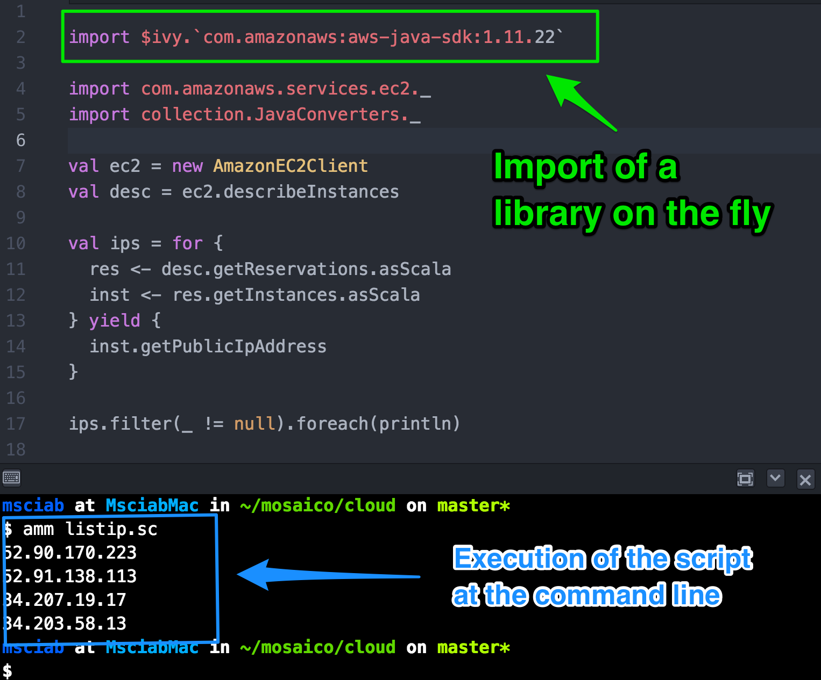

Introducing
Ammonite
by Li Haoyi
Used as
REPL in
Dotty
(Scala 3.0)

Slide 15
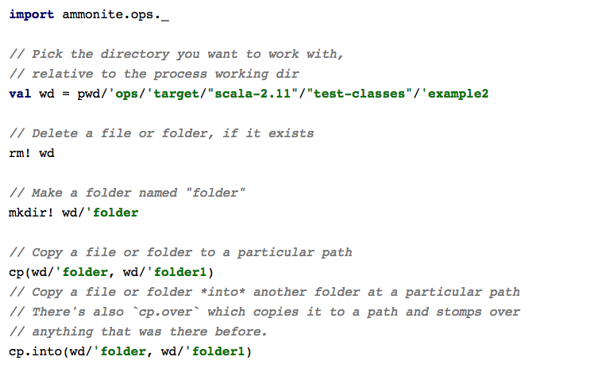
Ammonite Scripting features

Slide 16
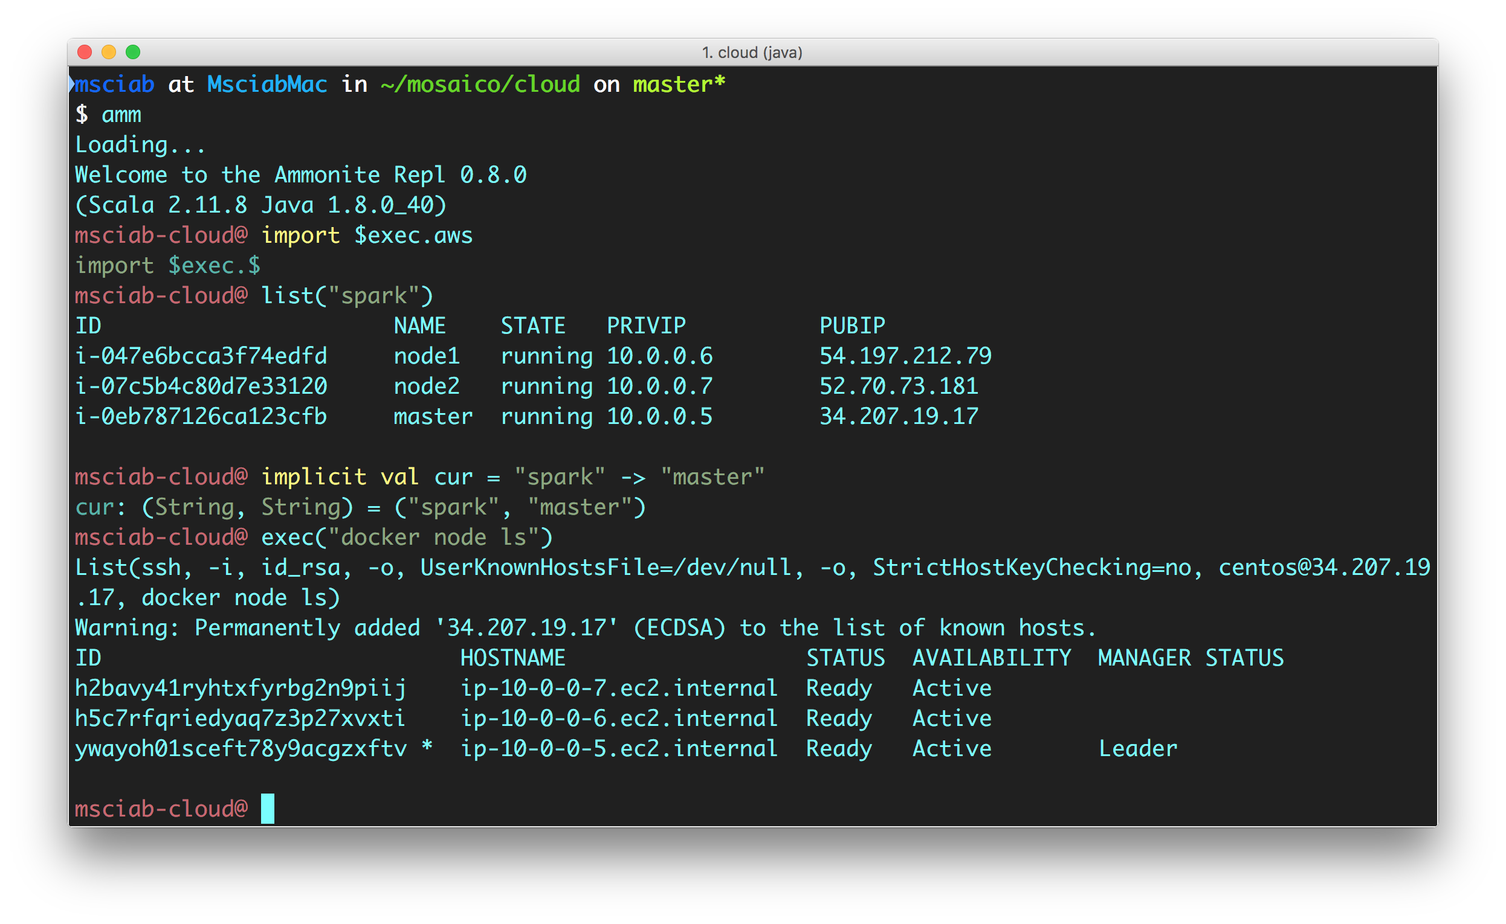
How a DevOps DevEnv Looks like

Slide 17
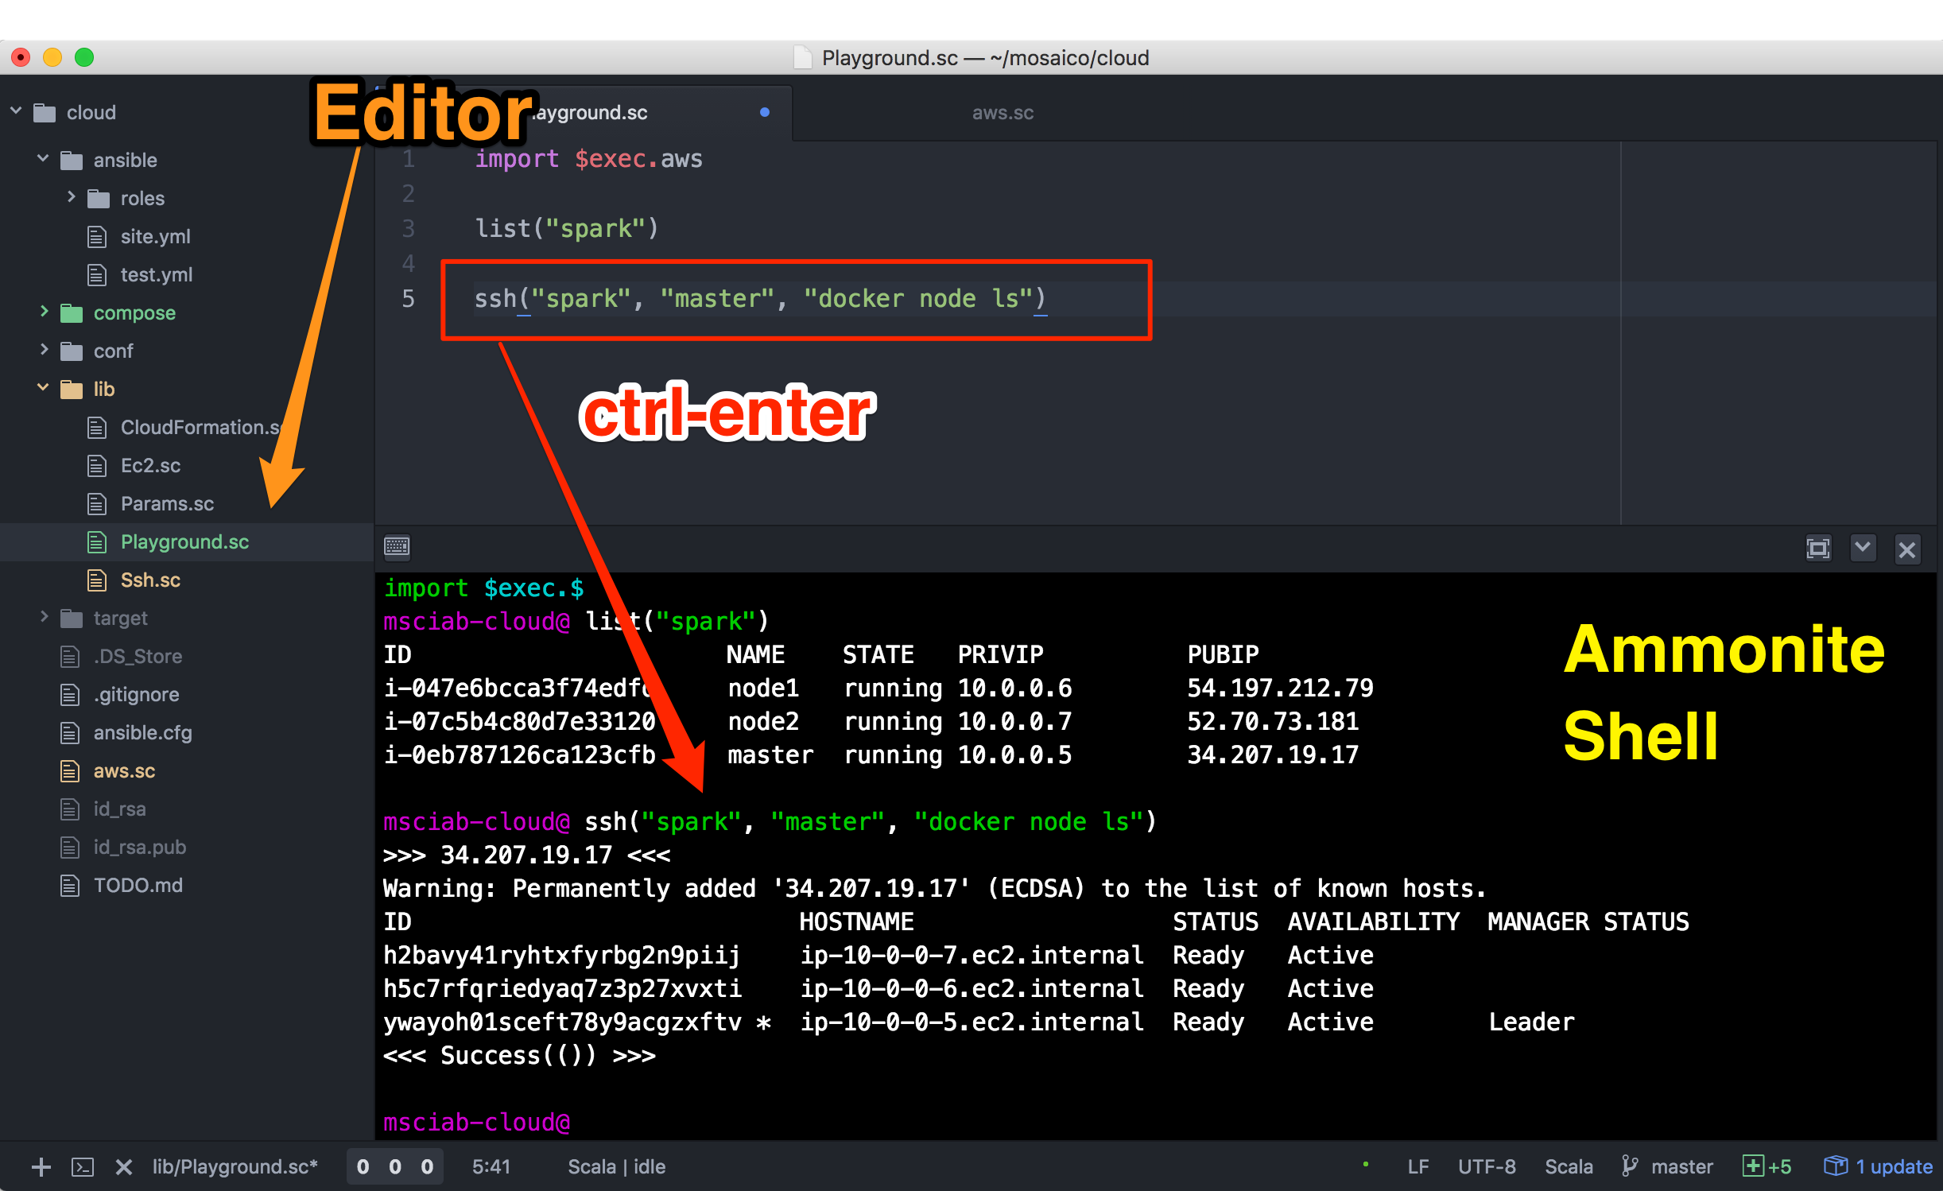
But we can do a bit better

Slide 18

Ammonite within Atom

Slide 19
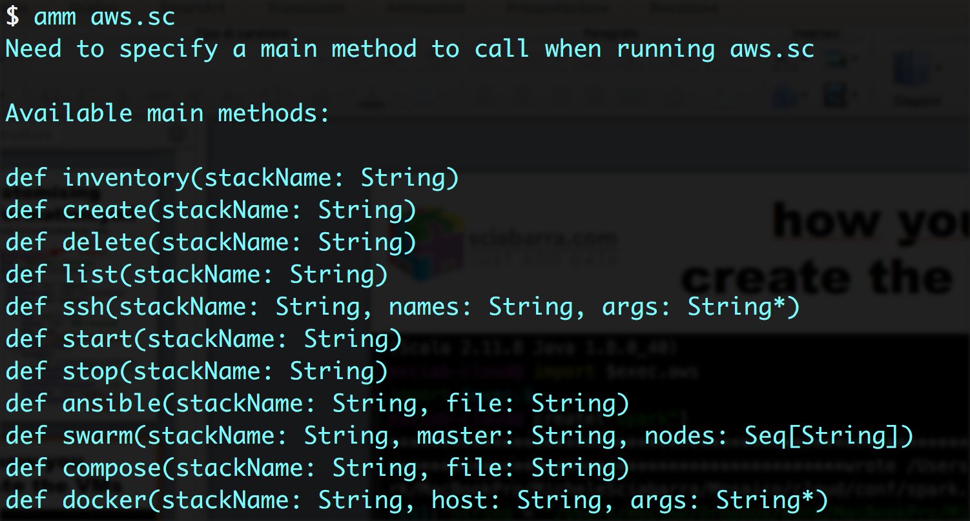
An Ammonite script to rule it all

Slide 20
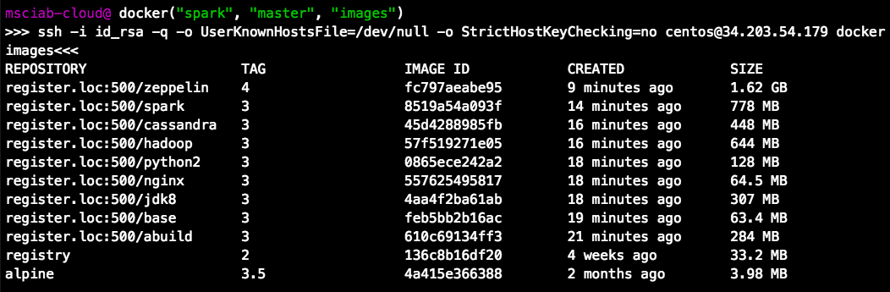
Building the Images

Slide 21
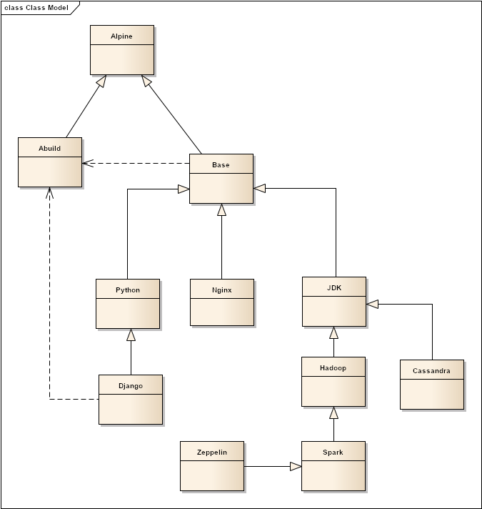
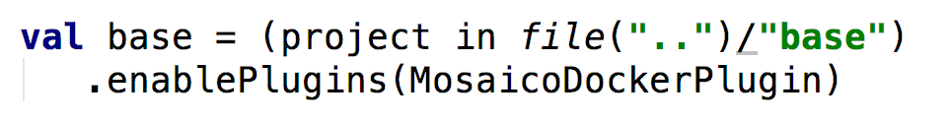
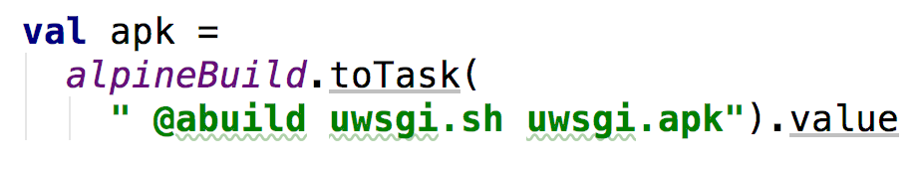
Building Images with SBT

Slide 22
The base Image
Built on top of Alpine Linux
an "in-memory" ultrasmall linux distro
Daemontools
provides monitoring of applications
Augeas
Configuration file helper
Serf
Provides autodiscovery and inter-container communication

Slide 23
What is wrong about Dockerfile?
Why do I need SBT to build images?
No preprocessing available
download
move files around
No dependencies between containers
No builds using other containers
No configuration files
No profiles

Slide 24
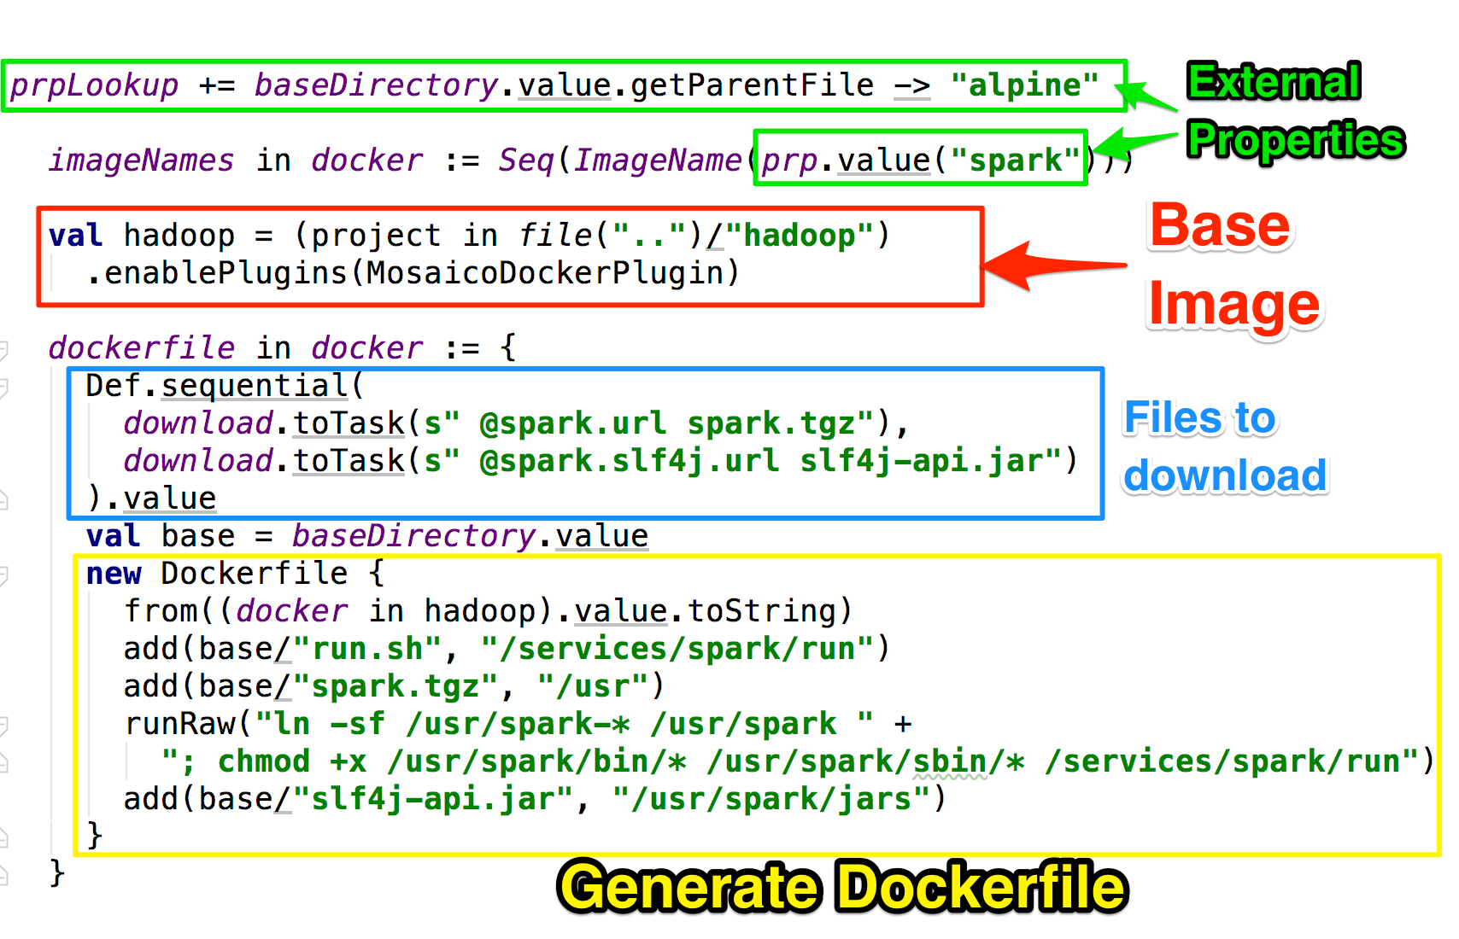
Building with SBT-DOCKER

Slide 25
MosaicoDocker SBT Plugin
Extends SBT-DOCKER
Model dependencies between containers
Can script Dockerfile generation in scala
External configuration files
Downloading of files before building the image
Ability to compile and build packages using other images
Smart "unpacking" of archives (removing unnesessary files)

Slide 26



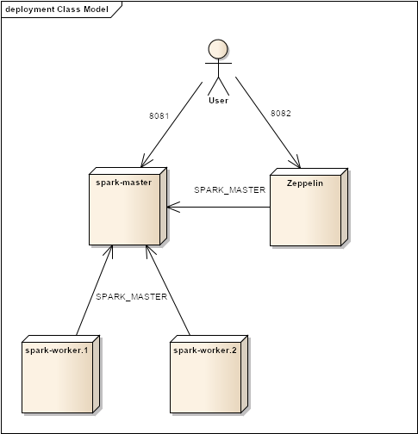
Four Steps to the Enlightment
1
2
3
4

Slide 27
Step 1: building the cloud
Ammonite
Actually: creating the VMs....

Slide 28
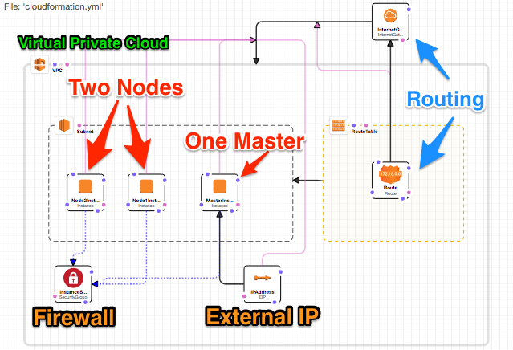
Cloud Formation

Slide 29
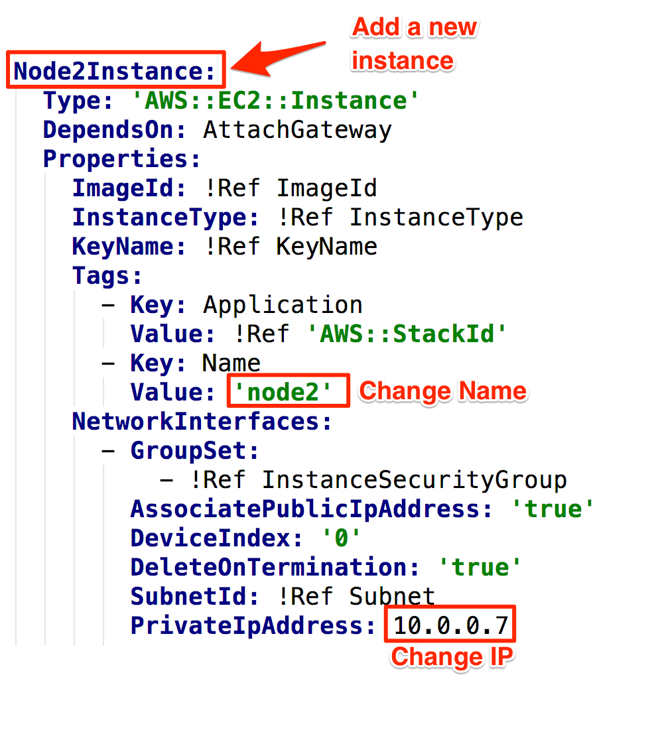
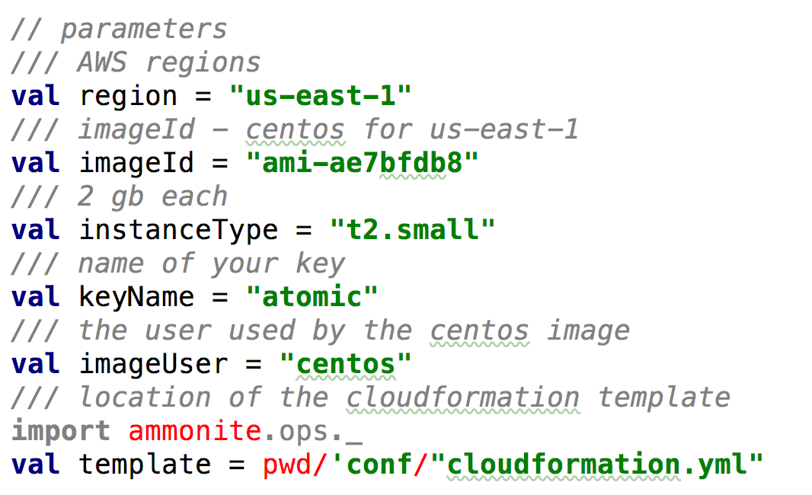
Customising cloudformation.yml
conf/cloudformation.yml
lib/Params.sc

Slide 30
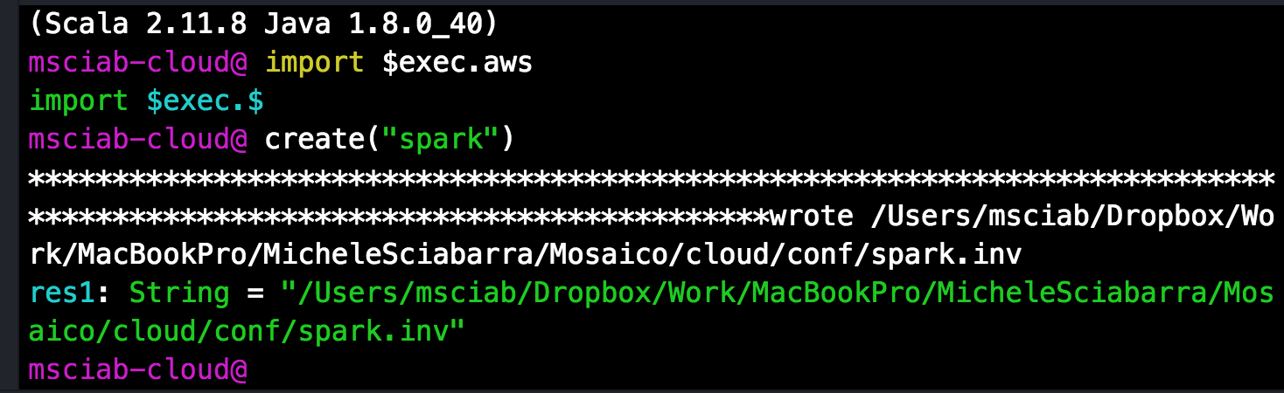
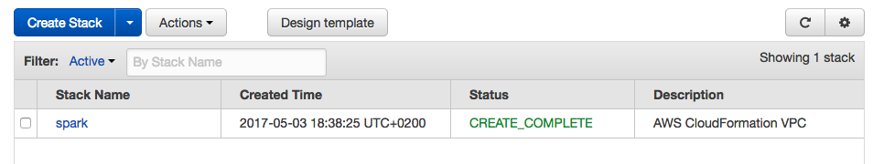
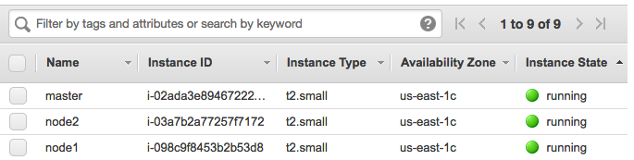
how you create the VMs

Slide 31
CloudFormation in Action

Slide 32
Step 2 Deploying Docker Swarm
Ammonite

Slide 33
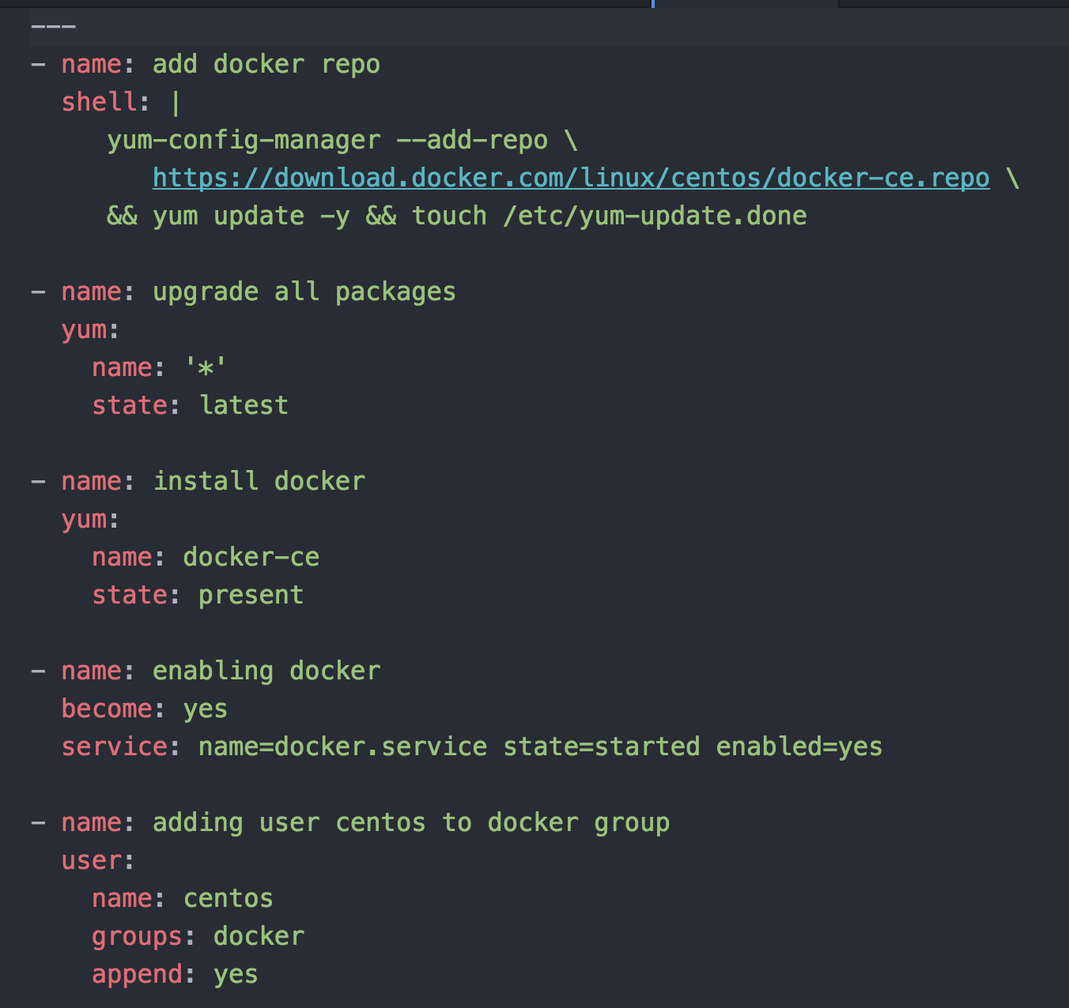
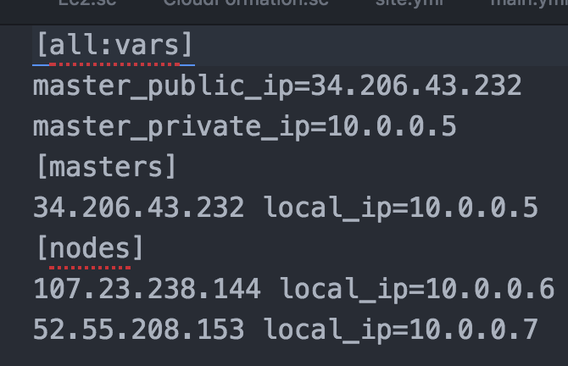
How ansible looks like
A collection of tasks
An inventory file
(generated)

Slide 34
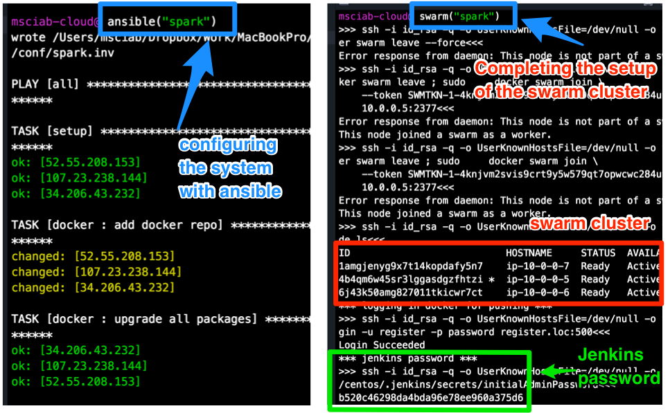
Ansible & Swarm

Slide 35
Ansible & Swarm

Slide 36
Step 3. Building Docker Images

Slide 37
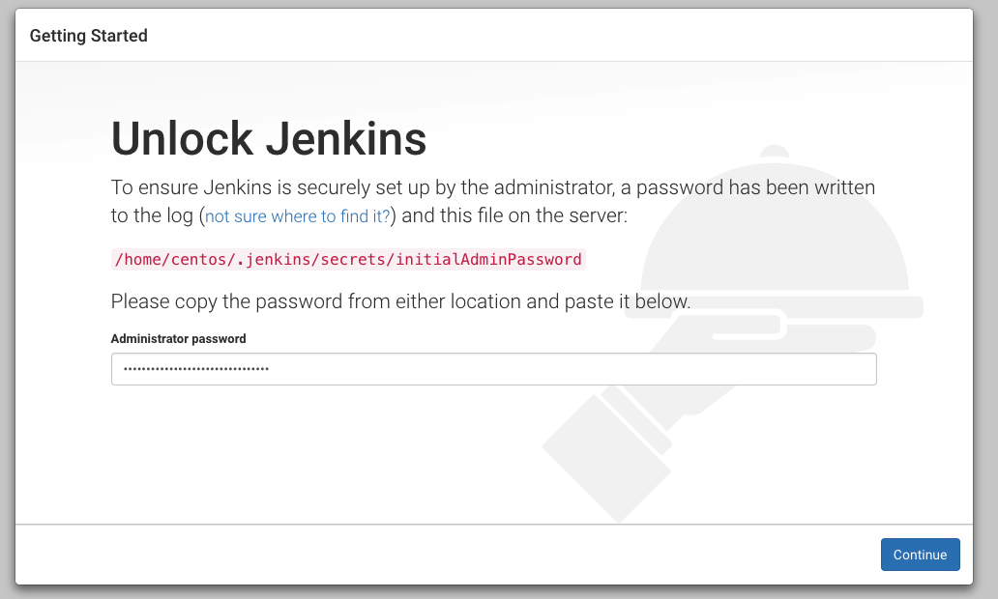
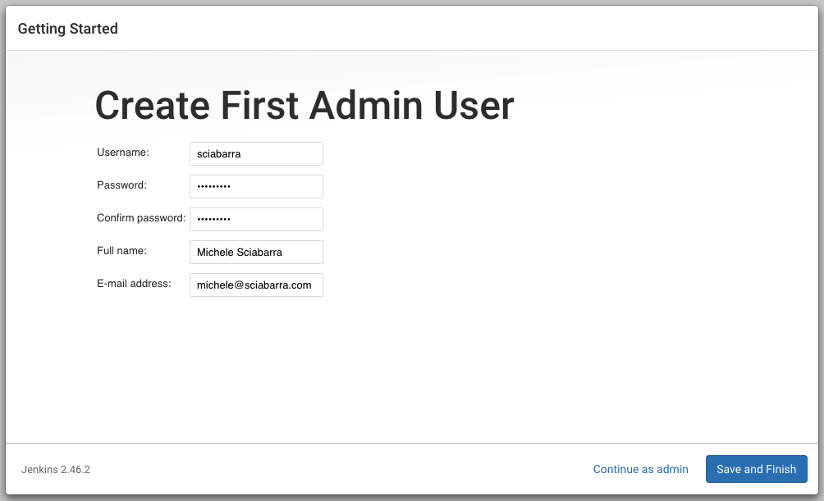
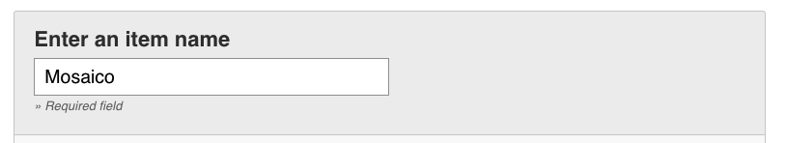
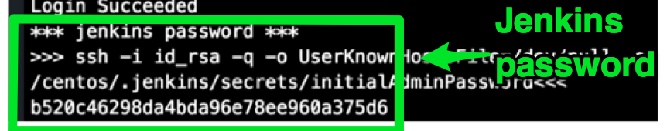
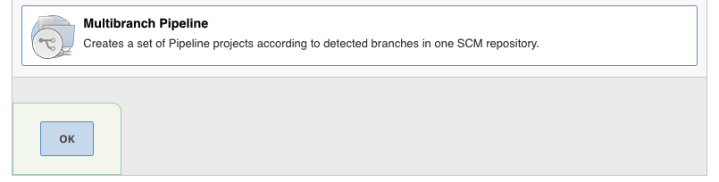
Preparing Jenkins
1
2
3

Slide 38
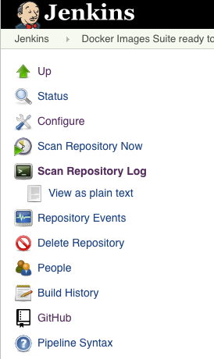
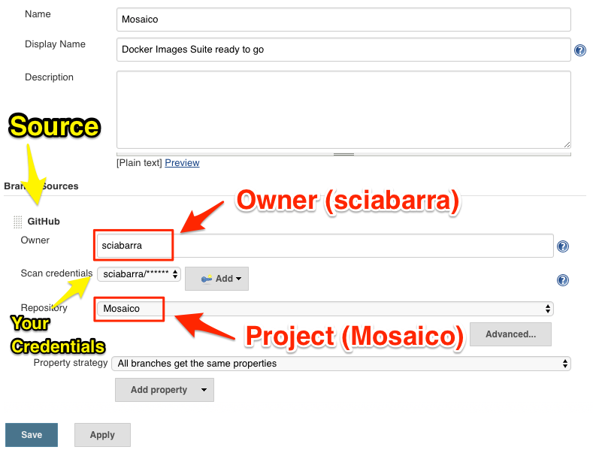
Create a Jenkins Job to build
4

Slide 39
Building Images with Jenkins

Slide 40
Final Result

Slide 41
Step 4 Orchestrate
Ammonite
Docker Compose

Slide 42
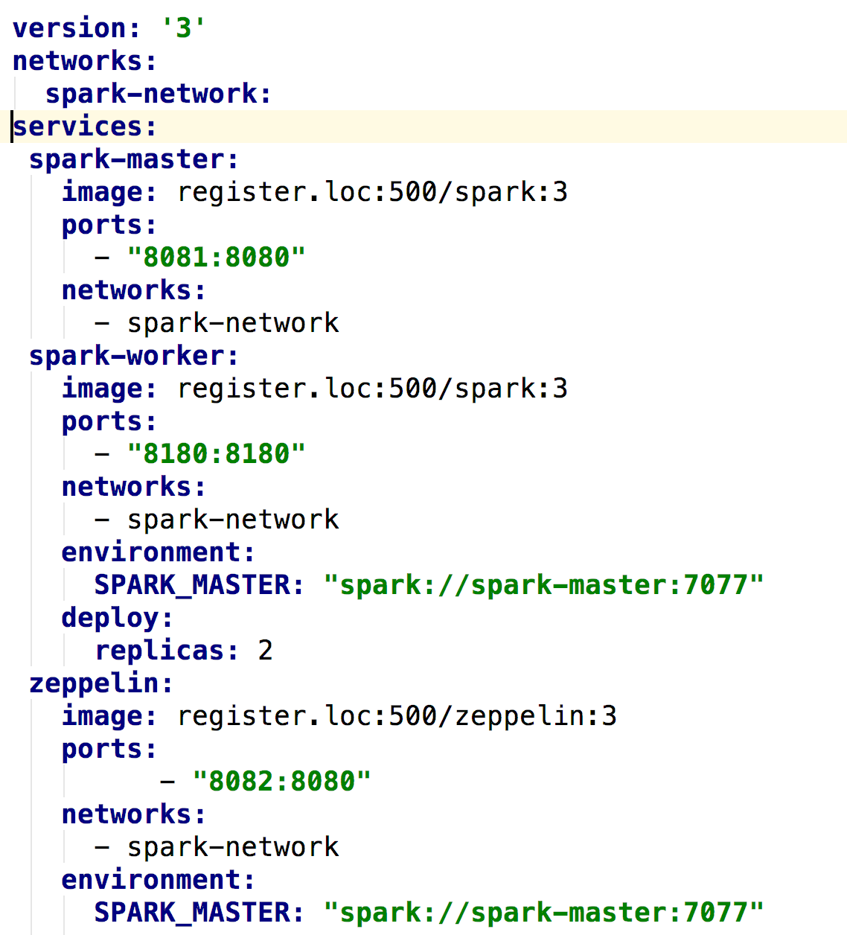
Orchestrate

Slide 43
Orchestration

Slide 44

Thank You!

